Slide 1
Monetary Policy

Slide 2
What is Monetary Policy?
Monetary policy is the behavior of the apex bank concerning the money supply.
Interest rates are the key area of Monetary Policy.
Basis of Monetary Policy is that there is a long run relationship between the amount of money and inflation
Demand for Money – the amount people wish to hold as cash as opposed to other assets
The Supply of Money – the amount
of money in circulation in the economy

Slide 3
Cont….
The Classical Quantity Theory of Money:
MV = PY
  (where M = the money stock, V = velocity of circulation, P = price level and Y = level of national income
More formally: M_{d} = k PY where:
  P is the price level
  Y is the level of real national income
  M_{d} is demand for money for transactions purposes
  K = proportion of national income held as transactions balances
In equilibrium M_{d} = M_{s}
  So: P = 1/kY x M
  A rise in Ms will lead to a proportional rise in P

Slide 4
In India
Four Measures of Money Supply:
M1 = CU + D (Narrow Money)
M2 = M1 + Savings deposits of post office savings banks
M3 = M1 + Net time deposits of banks (interbank deposits are netted out) (Broad Money)
M4 = M3 + total deposits with the post office savings banks (excluding NSC)
CU: coins and notes held by the public; D: demand deposits of the public with the banks (interbank deposits are excluded)

Slide 5
For a Commercial Bank
Deposits are liabilities.
Loans, bonds and cash reserves are assets.
Cash reserves for the banks include
Cash in hand + cash with RBI
CRR is an important instrument of monetary control.

Slide 6
For the RBI
Assets
Liabilities
Foreign Assets
Gold
Domestic assets (loan to GOI and banks)
Currency
Deposits of banks
Deposits of GOI

Slide 7
Money Creation Processes
Liabilities of RBI (Monetary Base/Base Money/Reserve Money/High powered Money)
B = CU + R (B stands for monetary base)
in base money by Re 1 more than Re 1 in money supply (Money Multiplier)
CU: Currency in circulation
R: Reserve by the banks at RBI

Slide 8
Asset Side Definition
As RBI’s assets and liabilities must be equal by balance sheet identity, it implies
B = FA + DC
FA: stock of foreign assets (+ gold) by RBI
DC: Domestic credit (Loans to GOI and commercial banks)
Thus B = CU + R = FA + DC

Slide 9
Initially, for simplicity, we assume
Public hold no currency (CU =0), use cheques for payments
No dearth for demand for bank loans
Assets of banks consist of only commercial loans.

Slide 10
Let the CRR be k.
Fraction k of total deposits to be kept as reserve with RBI
Thus the equations are:
B = R (1)
Ms = D (2)
R = kD (3)
Thus, Ms = (1/k) B
Money supply = Money Multiplier (1/k) X Monetary Base
1/k > 1, because it is the inverse of fractional CRR.

Slide 11
Money Creation in Perpetuity
New Deposits New loans & Cash reserve balances
investments
Original Bank $100 M $80 M $20 M
2nd generation bank 80 64 16
3rd generation bank 64 51.2 12.8
4th generation bank 51.2 41.0 10.2
5th generation bank 40.9 32.8 8.2
6th generation bank 32.8 26.2 6.5
7th generation bank 26.2 21.0 5.2
8th generation bank 21.0 16.8 4.2
9th generation bank 16.8 13.4 3.4
10th generation bank 13.4 10.7 2.7
Sum of first 10 banks $446 M $357 M $89 M
Sum or remaining banks $54 M $43 M $11 M
Total for Entire banking system $500 M $400 M $ 100 M
Monetary base = $100 million (reserves)
Total quantity of money = $500 million
Money Creation

Slide 12
Money creation in perpetuity
Assuming k = 10%, if government purchases goods worth of Rs 100 from A and pays him drawing a cheque on its account at the RBI.
Total rise in D = 100 + 90 + 81 + …….
= 100(1 + 0.9 + (0.9)² + (0.9)³ +-----)
= 100 (1/1-0.9)= 1000
Critical Assumption:
Banks can always find borrowers.

Slide 13
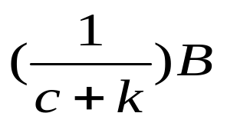
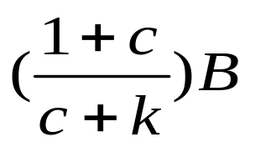
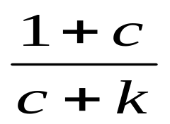
Relaxing the Assumption of
“No Currency with the Public”
If we assume that desired currency holding is proportional to demand deposits,
CU = cD where 0<c<1
B = CU + R = cD + R = (c + k)D
D =
Ms = CU + D = (1+c)D =
This money multiplier is smaller than 1/k.
Thus c is a leakage.

Slide 14
A smaller c implies less leakage.
Multiplier can be raised, if payments habit changes (from cash to cheque, credit cards, ATM)
Ms will rise if
k (CRR) decreases.
c (public’s desired currency-deposit ratio) falls.
B increases.

Slide 15
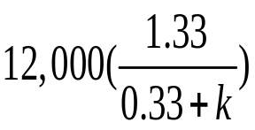
Numerical solutions
Q: In our economy, monetary liabilities of RBI is Rs 10,000 and govt money is Rs 2,000. The currency-deposit ratio is 0.33. RBI’s money supply target is Rs 45,000.
Find the reserve ratio, the RBI must impose on banks to achieve the money supply target.
Ans: High Powered Money= Monetary liabilities of RBI + govt money = 10,000+2,000=12,000
Currency-deposit Ratio= 0.33
Money supply: Rs 45,000
45,000 =
45,000(0.33+k) = 12,000 X 1.33
45,000k = 15.960-14,850 Thus, k = 1110/45,000 =0.025

Slide 16
The Demand for Money
The main concern in the study of the demand for money is:
  How much of financial assets one wants to hold in the form of money, which does not earn interest, versus how much one wants to hold in interest-bearing securities, such as bonds.
There is a trade-off between the liquidity of money and the interest income offered by other kinds of assets.
The transaction motive is the main reason that people hold money—to buy things.

Slide 17
The Transaction Motive
There are only two kinds of assets available to households: bonds and money.
The typical household’s income arrives once a month, at the beginning of the month.
Spending occurs at a completely uniform rate—the same amount is spent each day.
Spending is exactly equal to income for the month.

Slide 18
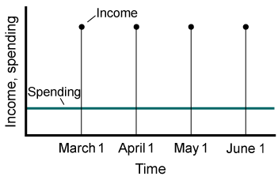
The Non-synchronization of Income and Spending
The mismatch between the timing of money inflow to the household and the timing of money outflow for household expenses is called the non-synchronization of income and spending.
Income arrives only once a month, but spending takes place continuously.

Slide 19
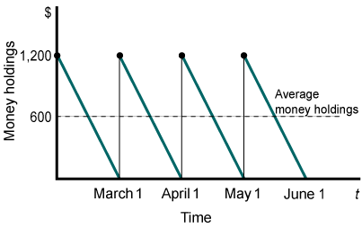
Money Management
Alex could decide to deposit his entire paycheck ($1,200) into his checking account at the start of the month and run his balance down to zero by the end of the month.
In this case, his average money holdings would be $600.

Slide 20
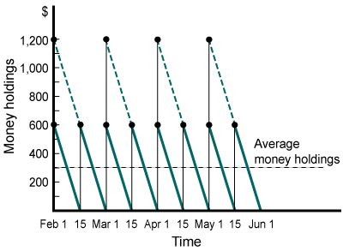
Money Management
Alex could decide to deposit half of his paycheck ($1,200) into his checking account, and buy a $600 bond with the other half. At mid-month, he could sell the bond and deposit the $600 into his checking account
Month over month, his average money holdings would be $300.

Slide 21
The Optimal Balance
There is a level of average money holdings that earns Alex the most profit, taking into account both the interest earned on bonds and the cost paid for switching from bonds to money. This level is his optimal balance.
  An increase in the interest rate lowers the optimal money balance. People want to take advantage of the high return on bonds, so they choose to hold very little money.

Slide 22
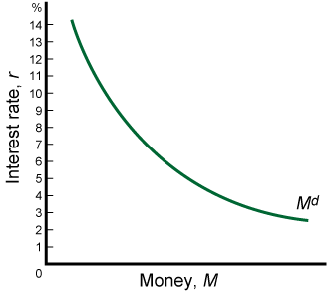
The Speculation Motive
The speculation motive: Because the market value of interest-bearing bonds is inversely related to the interest rate, investors may wish to hold bonds when interest rates are high with the hope of selling them when interest rates fall

Slide 23
The Total Demand for Money
The quantity of money demanded at any moment depends on the opportunity cost of holding money, a cost determined by the interest rate.
  A higher interest rate raises the opportunity cost of holding money and thus reduces the quantity of money demanded.

Slide 24
Transactions Volume and the Price Level
The total demand for money in the economy depends on the total dollar volume of transactions made.
The total dollar volume of transactions, in turn, depends on the total number of transactions, and the average transaction amount.

Slide 25
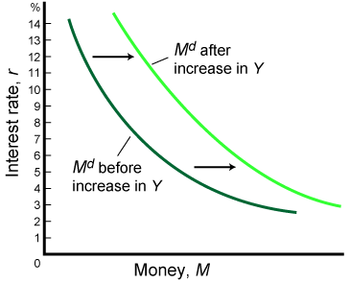
Transactions Volume and the Price Level
When output (income) rises, the total number of transactions rises, and the demand for money curve shifts to the right.

Slide 26
Transactions Volume and the Price Level
When the price level rises, the average dollar amount of each transaction rises; thus, the quantity of money needed to engage in transactions rises, and the demand for money curve shifts to the right.

Slide 27
The Determinants of
Money Demand: Review
Determinants of Money Demand
1. The interest rate: r (negative effect)
2. The dollar volume of transactions (positive effect)
a. Aggregate output (income): Y (positive effect)
b. The price level: P (positive effect)

Slide 28
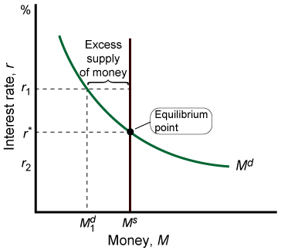
The Equilibrium Interest Rate
At r₁, the amount of money in circulation is higher than households and firms wish to hold. They will attempt to reduce their money holdings by buying bonds.

Slide 29
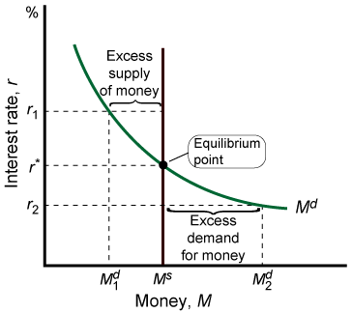
The Equilibrium Interest Rate
At r₂, households don’t have enough money to facilitate ordinary transactions. They will shift assets out of bonds and into their checking accounts.

Slide 30
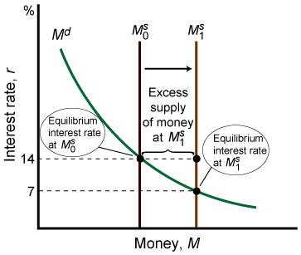
Changing the Money
Supply to Affect the Interest Rate
An increase in the supply of money lowers the rate of interest.

Slide 31
Tools of Monetary Control
Open Market Operation
Reserve Requirements
Bank Rate/Discount Rate

Slide 32
Open Market Operation
Buying and selling of govt bonds
If RBI buys bonds, it increases money supply.
A part of this may be kept as currency
Another part as deposits
Each new money held as currency increases money supply exactly by the equal amount.
Deposits increase reserve with banks and creates additional money.

Slide 33
Reserve Requirements
Cash Reserve Ratio (Minimum amount that the banks must hold as reserve against deposits): Affects money multiplier
SLR (Minimum amount that the banks must invest in govt securities)

Slide 34
Bank Rate/Discount Rate
The rate at which the RBI refinances other banks
An indirect measure
Two roles
Effect on banks’ borrowing and their reserves
Effect on interest rate leading to effect on reserve-deposit ratio and currency-deposit ratio (relationship is inverse)

Slide 35
Liquidity Adjustment facility
Repo rate: Rate at which RBI lends to banks (injection)
Reverse repo rate: Rate at which RBI borrows from banks (sucking out)
Transaction could be between 1-14 days.
It brings stability in short-term interest rates.
Call Money rate: Rate at which inter-banking transactions take place overnight.

Slide 36
MONETARY POLICY, REAL GDP,
AND THE PRICE LEVEL
Cause-Effect Chain: Interest rate Effect on AD
Money supply affects interest rates
Interest rates affect investment
Investment is a component of AD
Equilibrium GDP is changed

Slide 37
The Wealth Effect on AD
A lower price raises the real value of household’s money holding: wealth
Higher real wealth leads to higher consumption spending
Thus AD increases

Slide 38
The Exchange rate effect on AD
A lower price reduces r
Investors (bond seekers) move some of their funds overseas to earn higher returns.
This movement of funds causes real value of domestic currency to fall against foreign currency.
Domestic goods become less expensive relative to foreign goods.
This stimulates exports leading to increase in AD.

Slide 39
Foreign exchange market and Money supply
Suppose RBI sells $100 of foreign assets (FA) to X in exchange for Rs 5000.
X pays Rs 5000 in cash.
Two effects
Reduces RBI’s FA by $100
CU comes down by Rs 5000
Since Monetary base: CU + R, base falls.

Slide 40
Alternative Case….
If X pays in cheque payable at SBI
RBI reduces SBI’s reserve by Rs 5000.
Effect on monetary base is same.
These two cases suggest an equivalent change in monetary base

Slide 41
MONETARY POLICY AND EQUILIBRIUM GDP
S_{m1}
S_{m2}
S_{m3}
Investment
Demand
10
8
6
0
10
8
6
0
Real rate of interest, i
D_{m}
Quantity of money demanded and supplied
Amount of investment, i
AS
If the Money Supply
Increases to Stimulate
the Economy…
Interest Rate Decreases
P₃
Price level
Investment Increases
P₂
AD & GDP Increases
with slight inflation
P₁
AD₃(I=$25)
AD₂(I=$20)
Increasing money supply
continues the growth –
but, increases the Price Level.
AD₁(I=$15)
Real domestic output, GDP

Slide 42
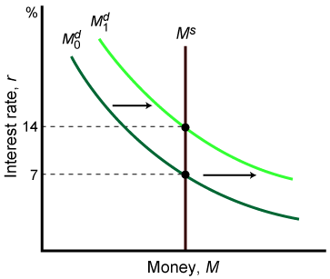
Increases in Y and Shifts in the Money Demand Curve
An increase in aggregate output (income) shifts the money demand curve, which raises the equilibrium interest rate.
An increase in the price level has the same effect.

Slide 43
The Demand for
Money: A Numerical Example
Table
1 NUMBER OF SWITCHESª | 2 AVERAGE MONEY HOLDINGS^{b} |  | 3 AVERAGE BOND HOLDINGS^{c} |  | 4 INTEREST EARNED^{d} | 5 COST OF SWITCHING^{e} |  | 6 NET PROFIT^{f}
r = 5 percent
0 |  | $600.00 | $ 0.00 | $ 0.00 |  |  | $0.00 | $ 0.00
1 |  | 300.00 | 300.00 | 15.00 |  |  | 2.00 | 13.00
2 |  | 200.00 | 400.00 | 20.00 |  |  | 4.00 | 16.00
3 |  | 150.00* | 450.00 | 22.50 |  |  | 6.00 | 16.50
4 |  | 120.00 | 480.00 | 24.00 |  |  | 8.00 | 16.00
Assumptions: Interest rate r = 0.05. Cost of switching from bonds into money equals $2 per transaction.
r = 3 percent
0 |  | $600.00 | $ 0.00 | $ 0.00 |  |  | $0.00 | $ 0.00
1 |  | 300.00 | 300.00 | 9.00 |  |  | 2.00 | 7.00
2 |  | 200.00* | 400.00 | 12.00 |  |  | 4.00 | 8.00
3 |  | 150.00 | 450.00 | 13.50 |  |  | 6.00 | 7.50
4 |  | 120.00 | 480.00 | 14.40 |  |  | 8.00 | 6.40
Assumptions: Interest rate r = 0.03. Cost of switching from bonds into money equals $2 per transaction.
*Optimum money holdings. ªThat is, the number of times you sell a bond. ^{b}Calculated as 600/(col.1+ 1). ^{c}Calculated as 600 – col.2.
^{d}Calculated as r x col.3, where r is the interest rate. ^{e}Calculated as t x col.1, where t is the cost per switch ($2). ^{f}Calculated as col.4 – col.5.

Slide 44
Targets of Monetary Policy
High and Stable Employment
Economic Growth
Price Stability
Financial Stability
Stability in the Foreign Exchange Market

Slide 45
Ultimate Vs Intermediate targets
Ultimate: Unemployment, Inflation, Growth of Real GDP
Intermediate: Money Supply and Interest Rates

Slide 46
Financial Sector Reforms in India
Pre-reforms Scenario
Regulated interest rates
Regulated financial investments
Restrictions of banks
Lack of competition
Nationalized banks to perform social duties at the cost of profitability
Cumulative rise in inefficiencies and NPAs
RBI lacked autonomy
GOI borrowed from RBI without limit through ad hoc treasury bill (basically overdraft)
SLR was very high (with low interest rates)
Household sector did not like to invest in these bonds.
CRR and SLR: 60% in early 1990s

Slide 47
Financial Sector Reforms
(Narasimham Committee, 1991)
Post-reforms Scenario
Lifting of regulations on interest rates on deposits and advances
Reduction of barrier to entry of pvt banks
Liberalization of branching regulations for both pvt and pub sector banks
Reduction of the appropriation of loanable funds by the GOI through gradual decrease in CRR and SLR

Slide 48
Move from a direct instrument (Administered interest rates, reserve requirements) to indirect instruments (OMO, purchase and repurchase of govt securities)
GOI has no power to control interest rates
Automatic monetization of deficit is under scanner.
Monetized deficit (short and long term borrowing from RBI) as a % of GDP has fallen from 2% in 1980-91 to 0.5% in 1992-2004.

